Slide 1


ITI Examination System Project
Meat Our Team
Ibrahim Abdelazeam
Computer Systems Engineering - 2023
Mahmoud Mohamed
Computer Systems Engineering- 2023
Haitham Fathy
Computer Systems Engineering- 2023
Ahmed Arab
Ziad Mohamed
Navigation Science & Space Technology -2024
Computer Systems Engineering -2023

Slide 2
Meet Our Team
ITI Examination System Project
Ibrahim Abdelazeam
Computer Systems Engineering - 2023
Mahmoud Mohamed
Computer Systems Engineering- 2023
Haitham Fathy
Computer Systems Engineering- 2023
Ahmed Arab
Ziad Mohamed
Navigation Science & Space Technology -2024
Computer Systems Engineering -2023

Slide 3
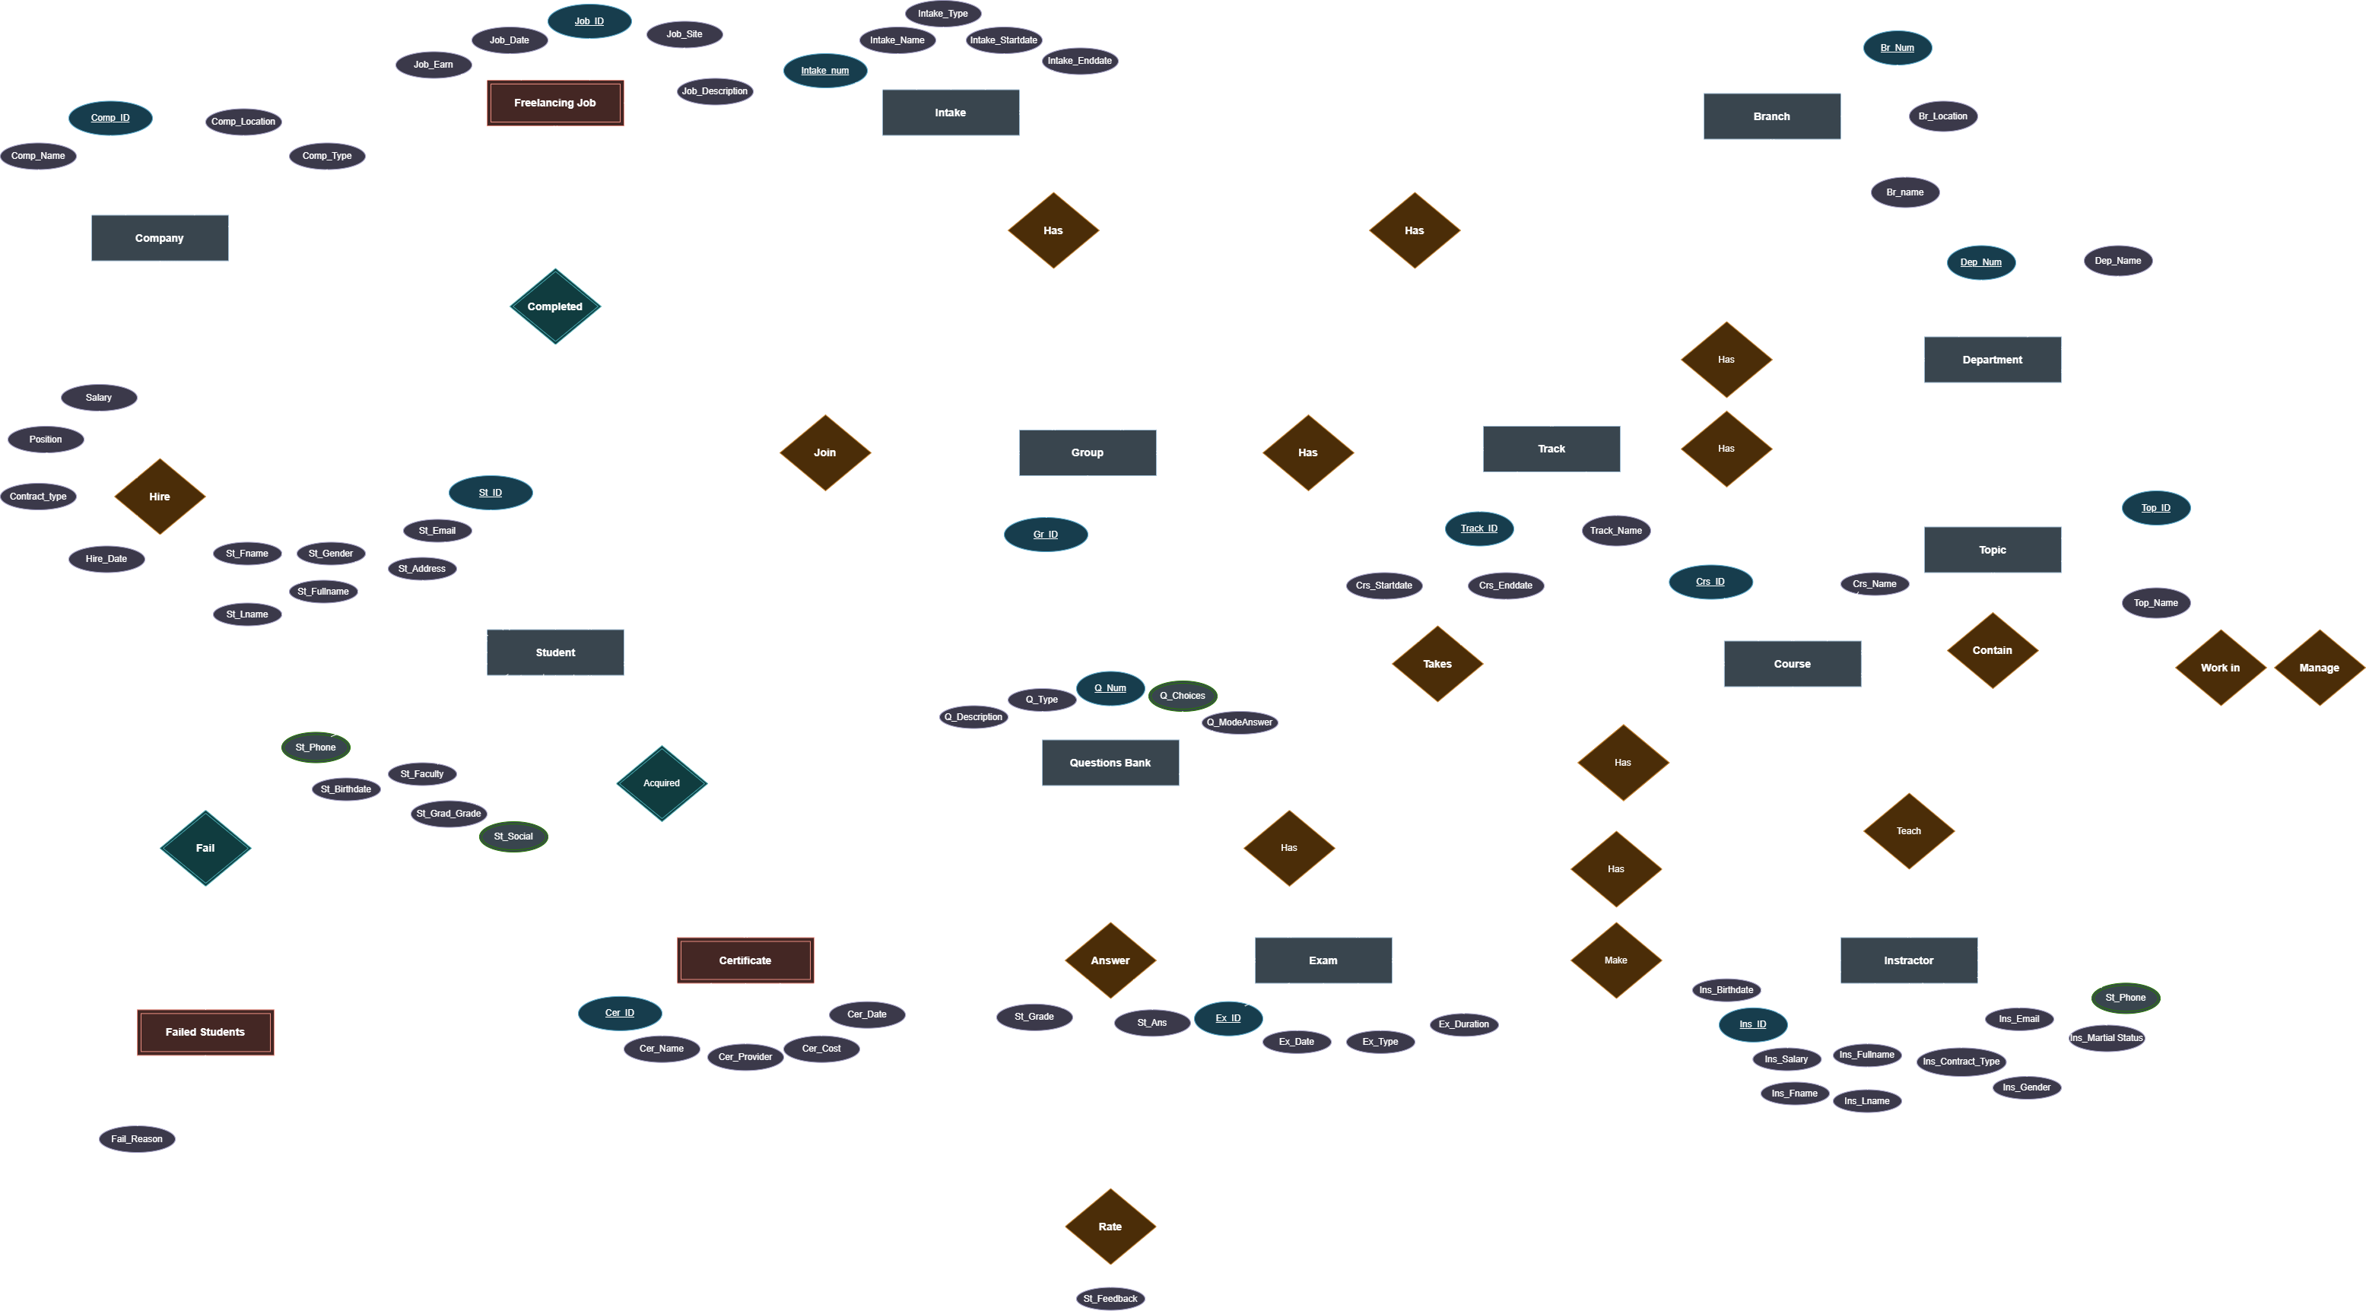
Meet Our Team
Content
1
ERD
2
Mapping
3
5
7
4
Database
BI Tools
Dashboards
6
AI Models
Automation
8
Web App
9
Project Preview
10
Task Allocation
Ibrahim Abdelazeam
Computer Systems Engineering - 2023
Mahmoud Mohamed
Computer Systems Engineering- 2023
Haitham Fathy
Computer Systems Engineering- 2023
Ahmed Arab
Ziad Mohamed
Navigation Science & Space Technology -2024
Computer Systems Engineering -2023

Slide 4
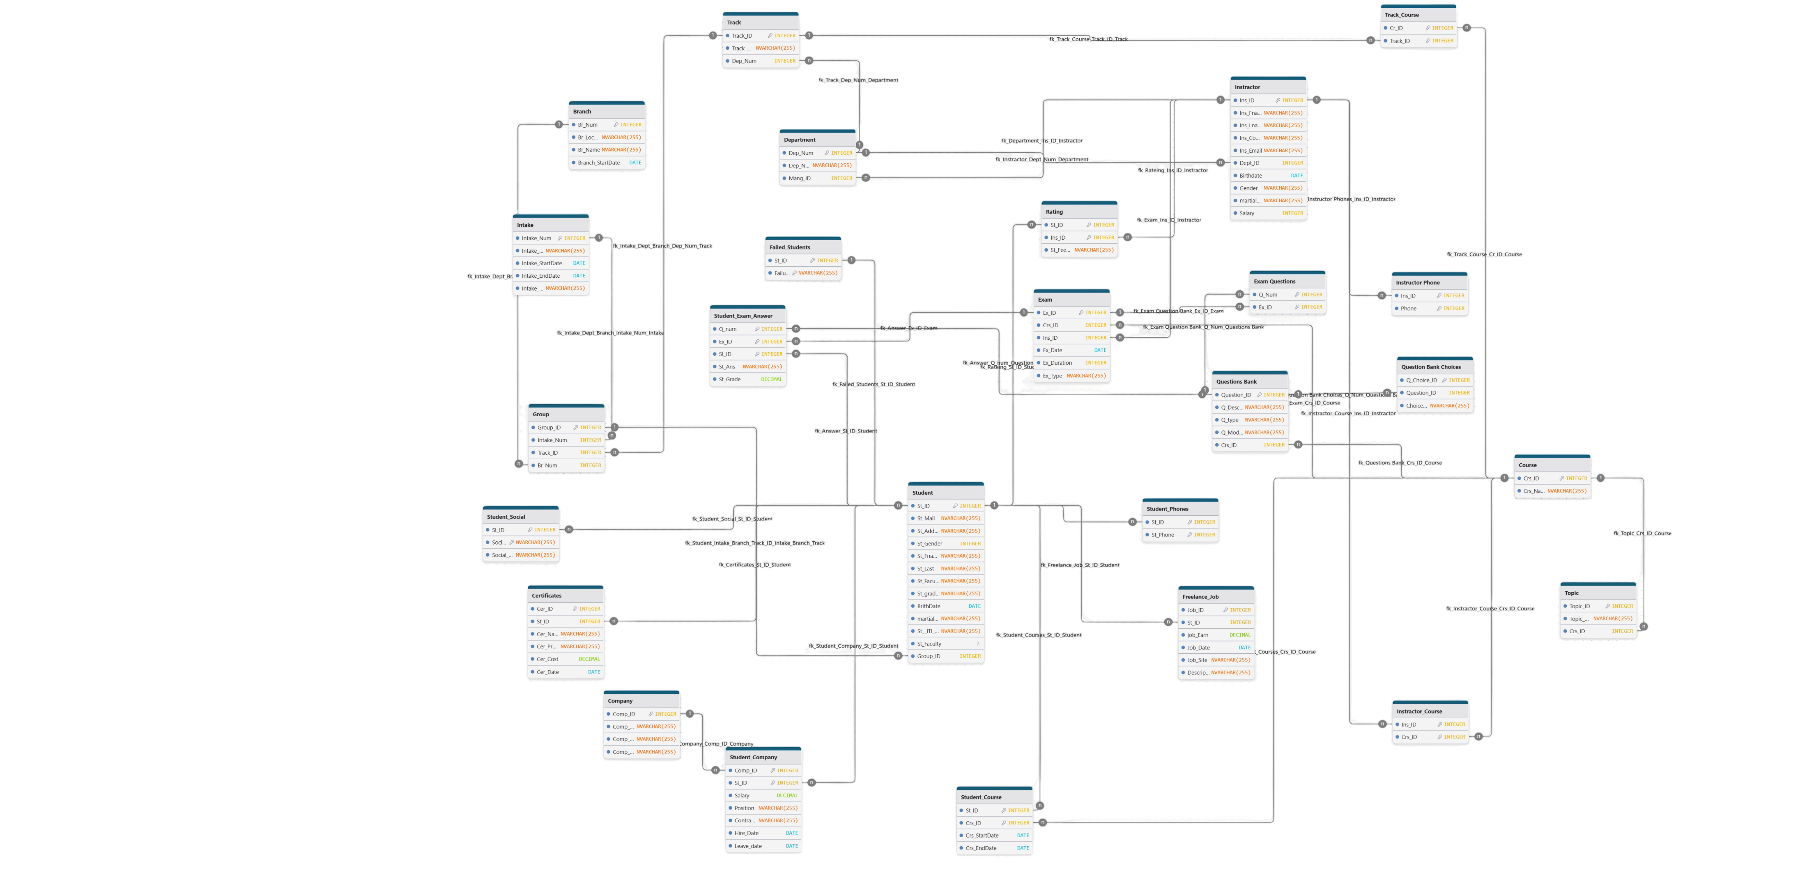
2
Mapping
1
ERD

Slide 5
3
Database
Database Creation
Data Generation
Procedures
Triggers
2
Mapping
1
ERD

Slide 6
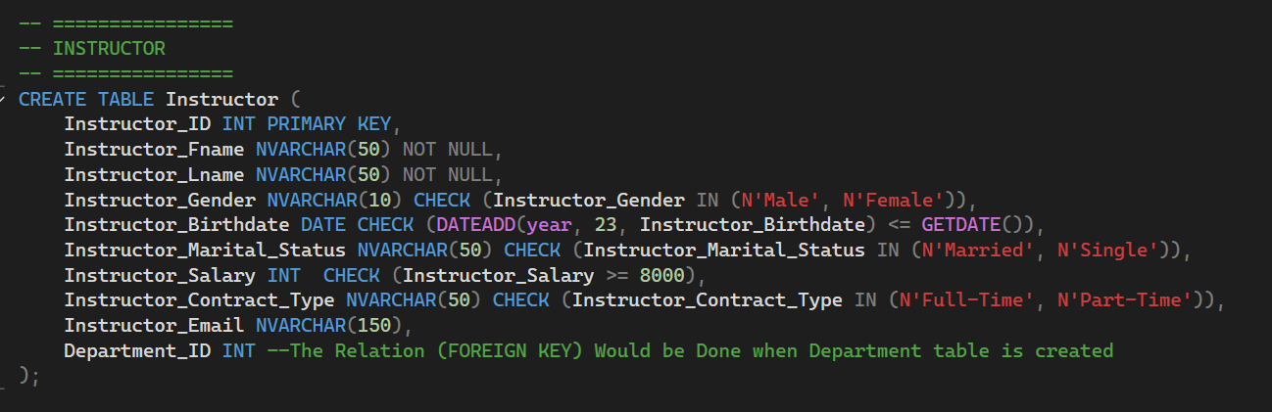
26 Table from 6 Categories
INSTRUCTOR
STUDENT
ORGANIZATIONAL STRUCTURE
EMPLOYMENT
COURSE
EXAMS & QUESTIONS
(Instructor , Instructor_Phone) Tables
(Department , Intake, Branch, Track, Group) Tables
(Student , Failed_Students, Student_Phone, Student_Social, Freelance_Job , Certificate, Rating) Tables
(Company , Student_Company) Tables
(Course ,Topics , Track_Course , Instructor_Course, Student_Course ) Tables
(Exam, Question_Bank, Question_Choice, Exam_Questions, Student_Exam_Answer ) Tables
3
Database
Database Creation
Data Generation
Procedures
Triggers
Creation Example
2
Mapping

Slide 7
Static Data Generation Example
Records: Approximately 2990 records inserted across multiple blocks
Pattern: Questions are linked to specific Course_IDs.
Pattern: Choices are linked to specific Question_IDs (only for 'MCQ' type questions). Choice_Text contains the potential answer options. Typically 3 choices per MCQ.
Question_Bank Table:
Question_Choice Table:
15 Question *7 Courses * 27 track + 50 for soft skills common between all tracks
Dynamic Data Generation Example
Step 1: Create 'Normal' Exams (Exam Table):
Records: 6192 inserted (516 groups * 12 courses/group).
Pattern: One 'Normal' exam is created for every course associated with every (group) that has students enrolled.
Records: 61920 inserted (6192 exams * 10 questions/exam).
Pattern: Each ‘Normal' exam created in Step 1 is assigned exactly 10 questions randomly selected from the Question_Bank for the corresponding Course_ID.
Step 3: Generate Initial 'Normal' Answers:
Records: 1,548,000 generated (25 students * 516 groups * 12 courses * 10 questions).:
Bias: A CorrectAnswerProbability is calculated for each student based on: Student_Faculty_Grade , Intake_Start_Date , Branch_Name
Step 2: Populate 'Normal' Exams (Exam_Questions Table):
Data Generation
Database Creation
3
Database
26 Table from 6 Categories
INSTRUCTOR
STUDENT
ORGANIZATIONAL STRUCTURE
EMPLOYMENT
COURSE
EXAMS & QUESTIONS
(Instructor , Instructor_Phone) Tables
(Department , Intake, Branch, Track, Group) Tables
(Student , Failed_Students, Student_Phone, Student_Social, Freelance_Job , Certificate, Rating) Tables
(Company , Student_Company) Tables
(Course ,Topics , Track_Course , Instructor_Course, Student_Course ) Tables
(Exam, Question_Bank, Question_Choice, Exam_Questions, Student_Exam_Answer ) Tables
Creation Example
Database size after data generation : 1.744 GB

Slide 8
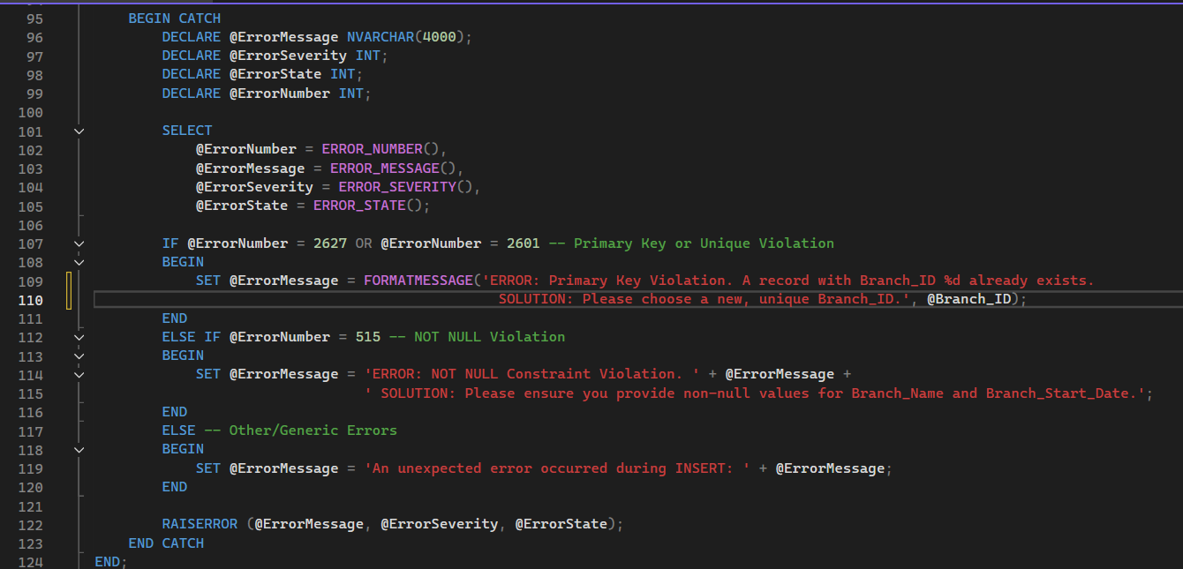
Procedures
3
Database
Data Generation
113 Procedure
Error Handling
4 (Select ,Insert ,Update , Delete ) * 26 (Tables Number) = 104
3 Custom Procedures
6 Report’s Procedure
Each error with custom massage
Primary key violation
Foreign key violation
Not Null Violation
Unique Violation
Static Data Generation Example
Records: Approximately 2990 records inserted across multiple blocks
Pattern: Questions are linked to specific Course_IDs.
Pattern: Choices are linked to specific Question_IDs (only for 'MCQ' type questions). Choice_Text contains the potential answer options. Typically 3 choices per MCQ.
Question_Bank Table:
Question_Choice Table:
15 Question *7 Courses * 27 track + 50 for soft skills common between all tracks
Dynamic Data Generation Example
Step 1: Create 'Normal' Exams (Exam Table):
Records: 6192 inserted (516 groups * 12 courses/group).
Pattern: One 'Normal' exam is created for every course associated with every (group) that has students enrolled.
Records: 61920 inserted (6192 exams * 10 questions/exam).
Pattern: Each ‘Normal' exam created in Step 1 is assigned exactly 10 questions randomly selected from the Question_Bank for the corresponding Course_ID.
Step 3: Generate Initial 'Normal' Answers:
Records: 1,548,000 generated (25 students * 516 groups * 12 courses * 10 questions).:
Bias: A CorrectAnswerProbability is calculated for each student based on: Student_Faculty_Grade , Intake_Start_Date , Branch_Name
Step 2: Populate 'Normal' Exams (Exam_Questions Table):
Database size after data generation : 1.744 GB

Slide 9
Triggers
Procedures
3
Database
113 Procedure
Error Handling
4 (Select ,Insert ,Update , Delete ) * 26 (Tables Number) = 104
3 Custom Procedures
6 Report’s Procedure
Each error with custom massage
Primary key violation
Foreign key violation
Not Null Violation
Unique Violation
Static Data Generation Example
Records: Approximately 2990 records inserted across multiple blocks
Pattern: Questions are linked to specific Course_IDs.
Pattern: Choices are linked to specific Question_IDs (only for 'MCQ' type questions). Choice_Text contains the potential answer options. Typically 3 choices per MCQ.
Question_Bank Table:
Question_Choice Table:
15 Question *7 Courses * 27 track + 50 for soft skills common between all tracks
Dynamic Data Generation Example
Step 1: Create 'Normal' Exams (Exam Table):
Records: 6192 inserted (516 groups * 12 courses/group).
Pattern: One 'Normal' exam is created for every course associated with every (group) that has students enrolled.
Records: 61920 inserted (6192 exams * 10 questions/exam).
Pattern: Each ‘Normal' exam created in Step 1 is assigned exactly 10 questions randomly selected from the Question_Bank for the corresponding Course_ID.
Step 3: Generate Initial 'Normal' Answers:
Records: 1,548,000 generated (25 students * 516 groups * 12 courses * 10 questions).:
Bias: A CorrectAnswerProbability is calculated for each student based on: Student_Faculty_Grade , Intake_Start_Date , Branch_Name
Step 2: Populate 'Normal' Exams (Exam_Questions Table):
Database size after data generation : 1.744 GB
Audit Table
User Name & Device Name
Action Type
Modified Table
Date & Time
Record Before Action
Record After Action
Data Generation

Slide 10
113 Procedure
Error Handling
4 (Select ,Insert ,Update , Delete ) * 26 (Tables Number) = 104
3 Custom Procedures
6 Report’s Procedure
Each error with custom massage
Primary key violation
Foreign key violation
Not Null Violation
Unique Violation
4
BI Tools
3
Database
Triggers
Audit Table
User Name & Device Name
Action Type
Modified Table
Date & Time
Record Before Action
Record After Action
Modified Coulmn
Procedures
SSIS
SSAS
Quik Analysis and insights
Cube (Branch Performance)
Extract from OLTP(Enormous data to handle )
Transform throw SQL commands and lookups
Load to data warehouse for dashboards and analysis
Cube (Student Performance)

Slide 11
SSRS
4
BI Tools
SSIS
SSAS
Quik Analysis and insights
Cube (Branch Performance)
Extract from OLTP(Enormous data to handle )
Transform throw SQL commands and lookups
Load to data warehouse for dashboards and analysis
Cube (Student Performance)
Audit Table
User Name & Device Name
Action Type
Modified Table
Date & Time
Record Before Action
Record After Action
Triggers
3
Database

Slide 12

5
Dashboards
4
BI Tools
SSRS
Tableau
SSIS
SSAS
Quik Analysis and insights
Cube (Branch Performance)
Extract from OLTP(Enormous data to handle )
Transform throw SQL commands and lookups
Load to data warehouse for dashboards and analysis
Cube (Student Performance)

Slide 13
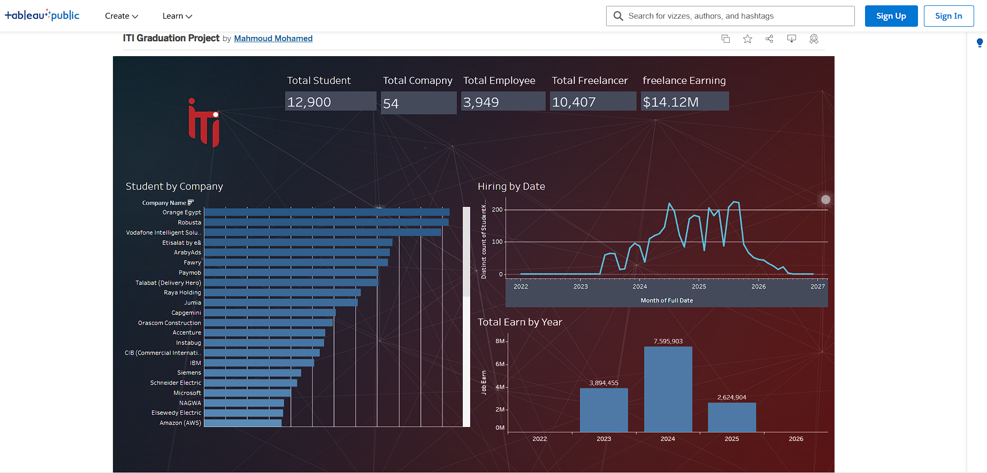
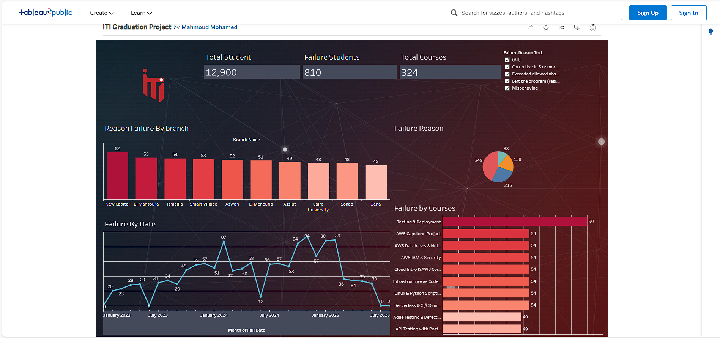
Power BI
5
Dashboards
Tableau
SSRS
4
BI Tools

Slide 14
6
AI Models
5
Dashboards
Power BI
Tableau
SSRS
4
BI Tools

Slide 15
6
AI Models
Grades Prediction
Employment Prediction
Text To SQL
Generate Dashboard
AI Demo
5
Dashboards
Power BI

Slide 16
7
Automation
Automation Process
Deployed Web Extract Data from Firebase and load submitted answers
Local code fetch submitted answers from Firebase and load it to local OLTP database (Each 3 Second)
Local code send data to real time database cloud (Firebase)
Gateway connect local OLTP to Power Bi Service
Connect online published reports to the gateway
6
AI Models
AI Demo
Grades Prediction
Employment Prediction
Text To SQL
Generate Dashboard
5
Dashboards

Slide 17
8
Web Application
7
Automation
Automation Process
Deployed Web Extract Data from Firebase and load submitted answers
Local code fetch submitted answers from Firebase and load it to local OLTP database (Each 3 Second)
Local code send needed tables from local database to real time database cloud (Firebase)
Gateway connect local OLTP database to Power Bi Service
Connect online published reports to the gateway
AI Demo
6
AI Models

Slide 18
8
Web Application
Automation Process
Deployed Web Extract Data from Firebase and load submitted answers
Local code fetch submitted answers from Firebase and load it to local OLTP database (Each 3 Second)
Local code send needed tables from local database to real time database cloud (Firebase)
Gateway connect local OLTP database to Power Bi Service
Connect online published reports to the gateway
7
Automation
AI Demo

